Slide 1

OOP Concepts
Object oriented programming

Slide 2
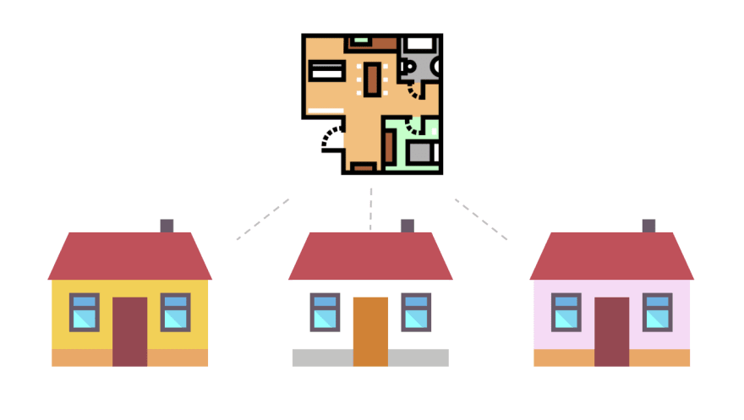
Class
A blueprint for creating an object
Class House
House 1
House 2
House 3

Slide 3
Object
An instance of a class
3 yellow, white & pink houses are 3 instances created from the blueprint of a house

Slide 4

What does a class have?
Attributes (data)
Behaviors (functions)
Attributes: weight, height
Behaviors: eat, sleep, run
When a cat eats, what changes?
When a cat sleep, what changes?

Slide 5

Behaviors can change attributes
eat
sleep

Slide 6
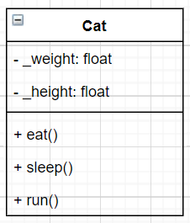
Represent a cat with UML
Universal Modeling Language – Class diagram
Attributes
Behaviors

Slide 7
Note
Class is a blueprint of object
Object is an instance of a class
A class has attributes & behaviors
Behaviors can change an object’s attributes
Use UML class diagram to model a class
Abstraction: focus on what is important

Slide 8
Exercise
Create UML diagram for
A soldier that has Hit points and Mana, can attack and defend
A simple fraction that has numerator and denominator
A Point in 2D space, with x and y location
A Line in 2D space, created by 2 points

Slide 9
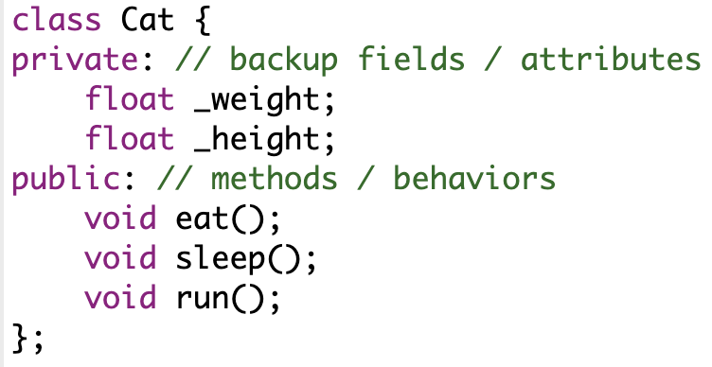
Coding

Slide 10
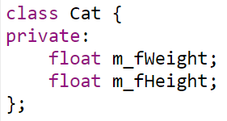
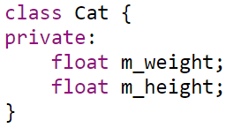
Other coding standard
Hungarian notation

Slide 11
Which coding standard to use?
Really depends on
Customer’s requirement
Language / Project
Team / Company
Chosen in this course:
_camelCase: private attribute
camelCase: public method, public constant, static
PascalCase: classname // Cat, Student, Course, Product

Slide 12
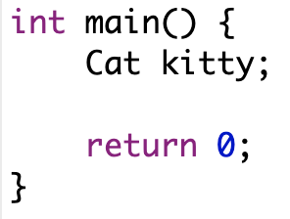
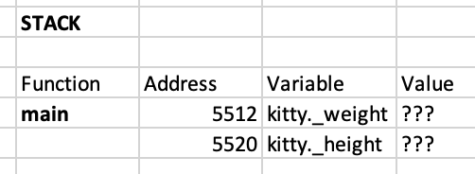
Creating a new cat

Slide 13
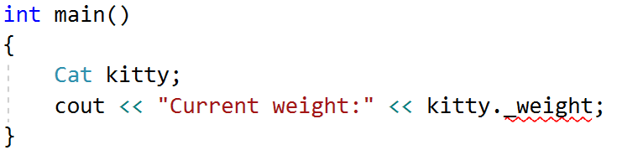
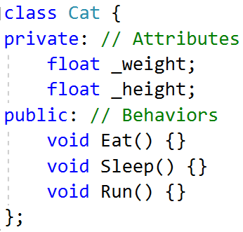
How to know the cat weight?
This code will produce error
“Cat::_weight': cannot access private member
Why?

Slide 14
Getter & Setter
For now, there are two types of scope for attributes & behaviors
Private: can be accessed inside class
Public: can be accessed from anywhere
To access private attributes, we should use getter & setter

Slide 15
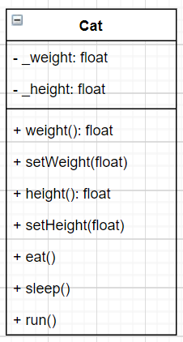
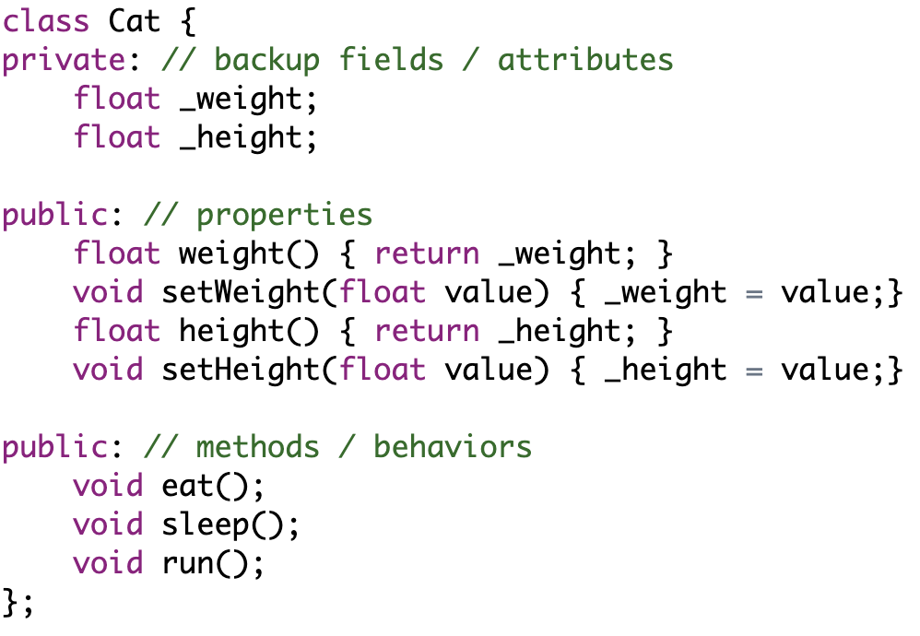
Coding for getter & setter
encapsulation
: state should be changed by members

Slide 16
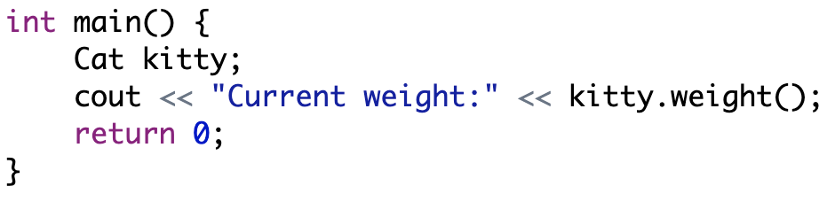
Now we can know the cat’s weight!
We haven’t set intial value yet!

Slide 17
Constructor & destructor

Slide 18
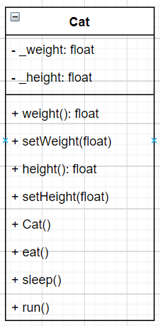
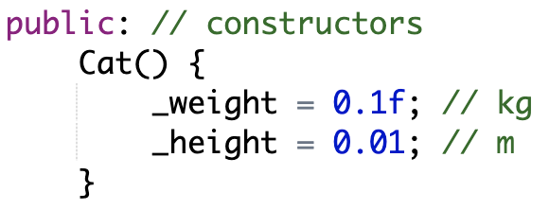
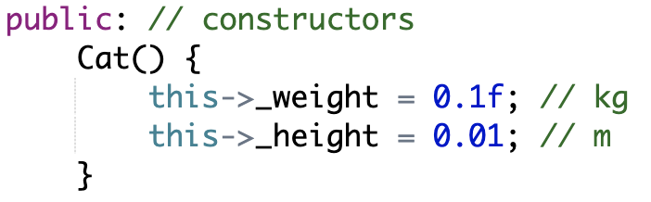
Constructor
Object needs to initialize its values in constructor

Slide 19
What is special about constructor?
Same name as class
Class Cat has constructor Cat()
Has no return type
Only write, no void needed!
Cat() {
}
Is called when an object is created!
So, when is object created?

Slide 20
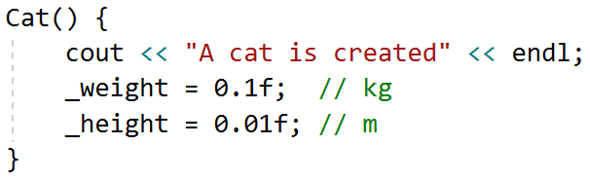

Example – Constructor will be called automatically
Let’s modified the constructor

Slide 21
What will happen if there is no constructor?
An empty constructor will be created for you
Actually, there are a lot of constructors that will be created automatically for you (will be showed later in this course)

Slide 22
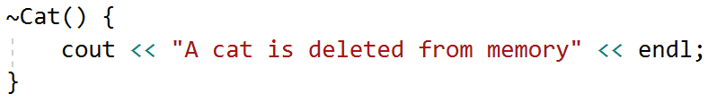
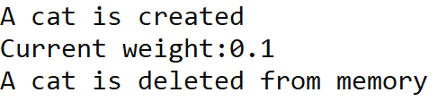
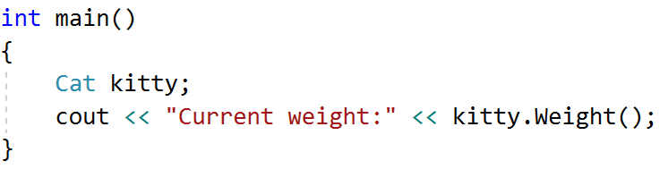
Destructor
Together with constructor, there exists destructor
Will be called befored an object is deleted

Slide 23
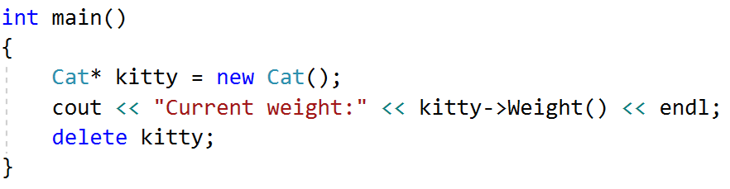
Manual allocation
Let’s change the main function from this
To this

Slide 24
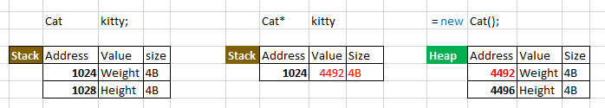
Quick look on pointer
A pointer is a variable that holds a memory address
It is a pointer so it has size of 4 bytes! Regardless of the data type it points to!
float size will be 8 bytes

Slide 25
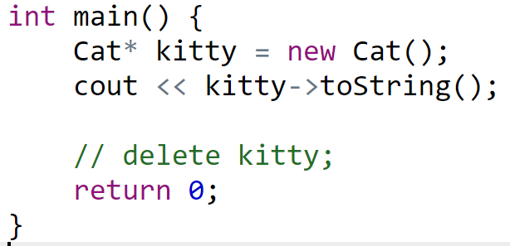
What will happen if we forgot to delete?
Memory leak
Solution? Smart pointer (later in this course)

Slide 26
What do we do on constructor & destructor?

Slide 27
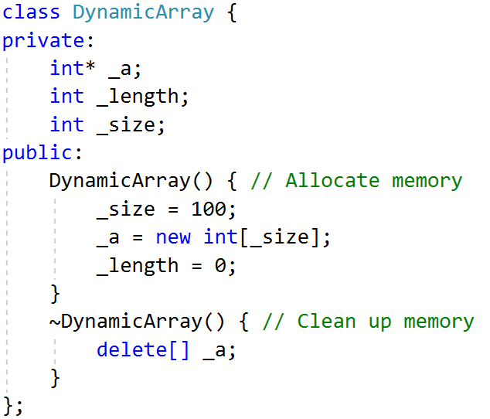
Dynamic array – Manual implementation
Pre allocate memory

Slide 28
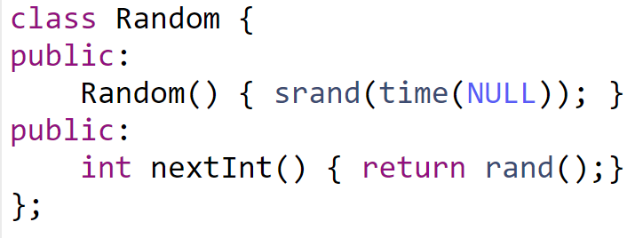
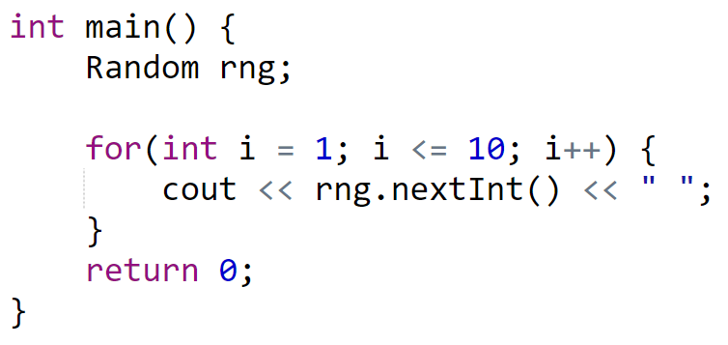
Random class
Initialize using seed

Slide 29
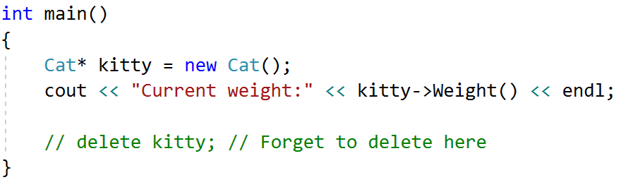

Careful – new without delete
Will create memory leak problem!
The memory block allocated for kitty is not revoked!

Slide 30
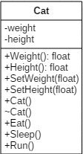
Quick overview
A class has
Private: Attributes
Public: Properties
Public: Constructor
Allocation if needed
Public: Destructor
Clean up unused memory block
Public: Methods (Behaviors)
this pointer
new & delete

Slide 31
Common obvious question
Why do we need to write getter & setter?
Short answer: it depends on the business requirement
Let’s take a look on some common examples

Slide 32
Getter types

Slide 33
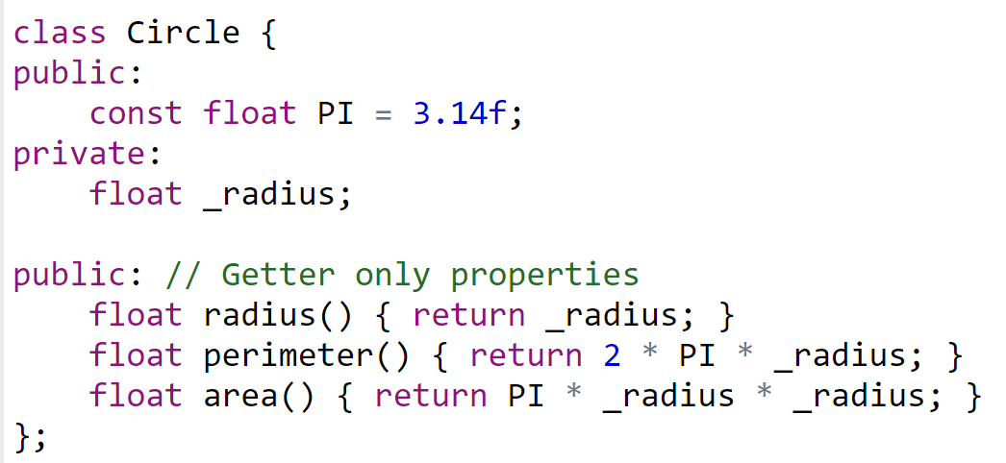
Derivative properties
Created from another attributes

Slide 34
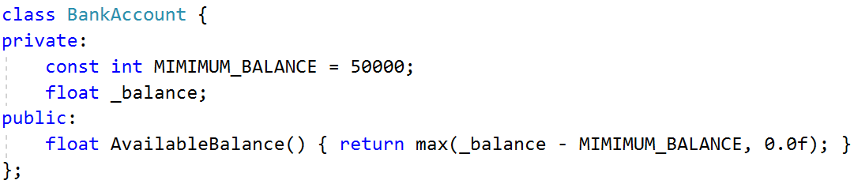
Getter with business logic

Slide 35
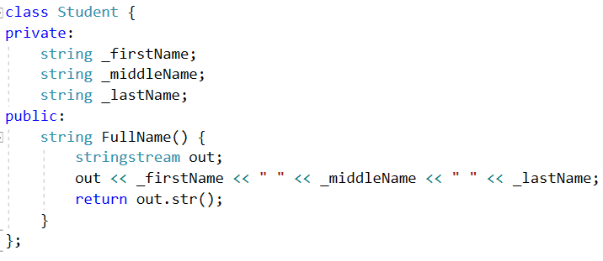
Combination from other atributes

Slide 36
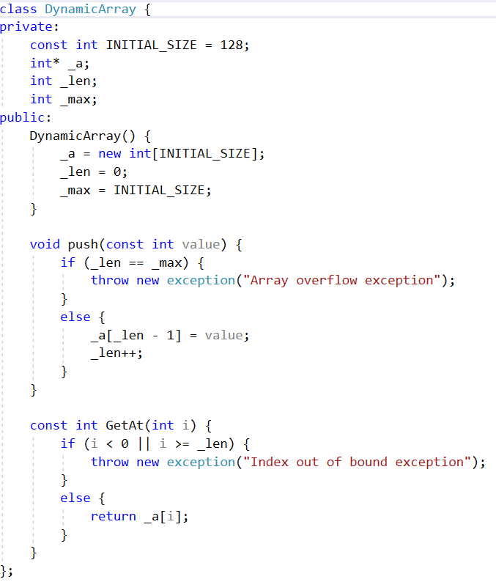
Validation

Slide 37
Parameterized constructor

Slide 38
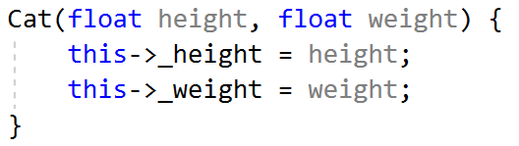
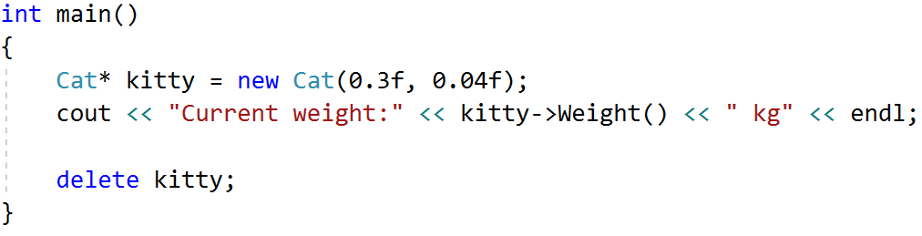

Parameterized constructor
What if we want to set the value manually for each attributes?

Slide 39
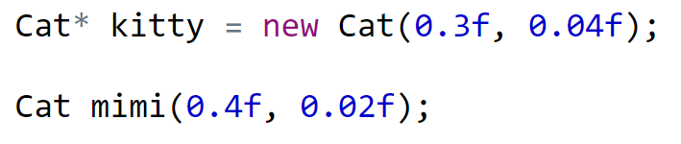
Two ways to used parameterized constructor

Slide 40
toString

Slide 41
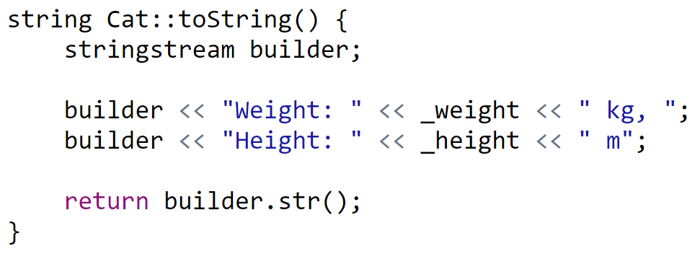
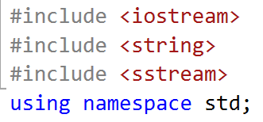
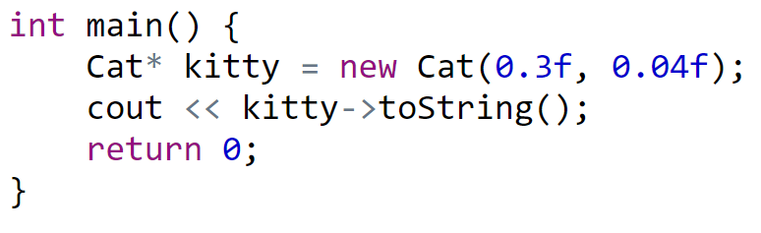

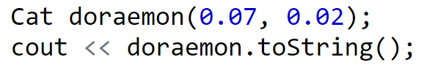
ToString
Simple example to simplified serialization

Slide 42
Summary
OOP for reusability, extensibility, maintainability
A class is blueprint to create objects
Object is an instance of the class
A class has attributes and methods
Data & Functions
Members can be private or public (for now)
this pointer is passed to methods
new to create (Constructor)
delete to destroy (Destructor)
UML diagram for class

Slide 43
Organizing class files

Slide 44
Recommended way
A class should be splitted into two files
Header file (Cat.h): class definition
CPP file (Cat.cpp): class implementation

Slide 45
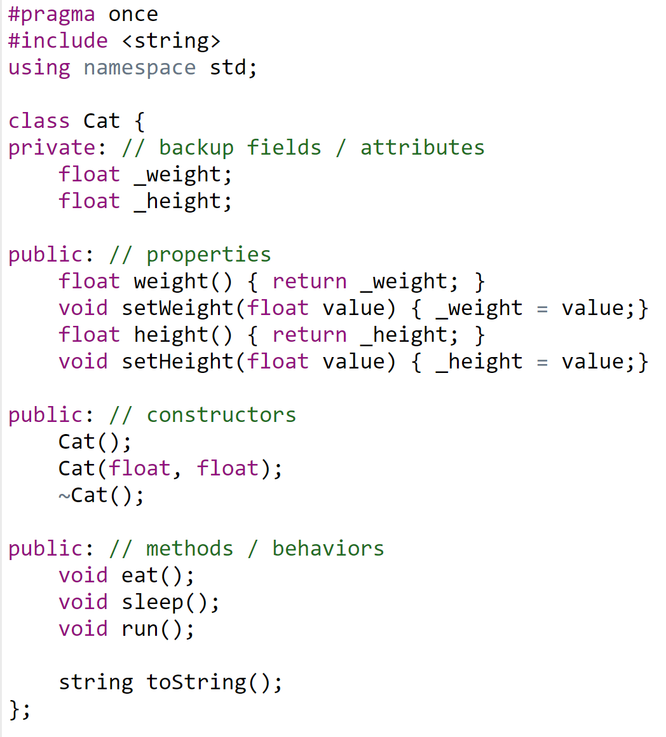
Cat.h

Slide 46
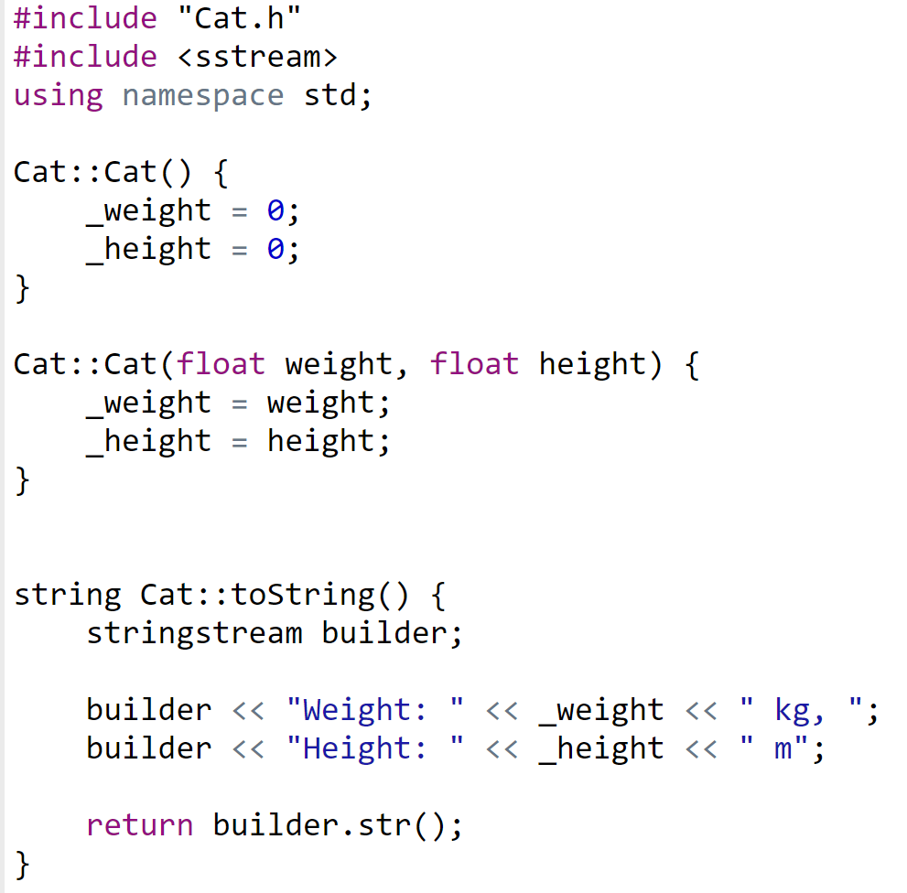
Cat.cpp

Slide 47
Exercises
Generate random 5 cats, 5 points, 5 soldiers, 5 Autobots and print out all objects attributes

Slide 48
Copy constructor

Slide 49

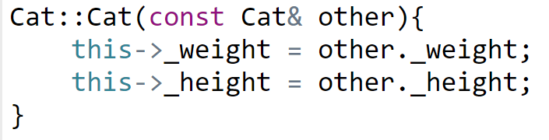
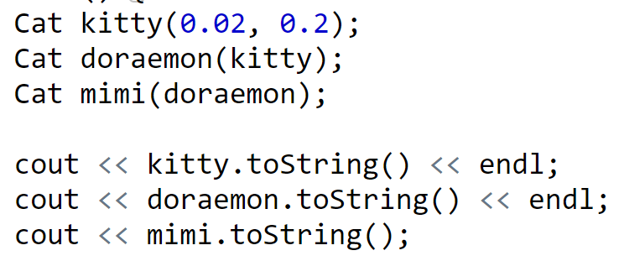
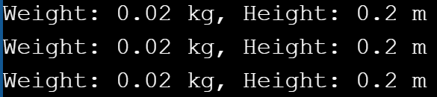
Declaration & Implementation

Slide 50
Actually
Without writing copy constructor, the below code still works
The compiler will automatically generate copy constructor for us
So when do we actually need to implement copy constructor?

Slide 51
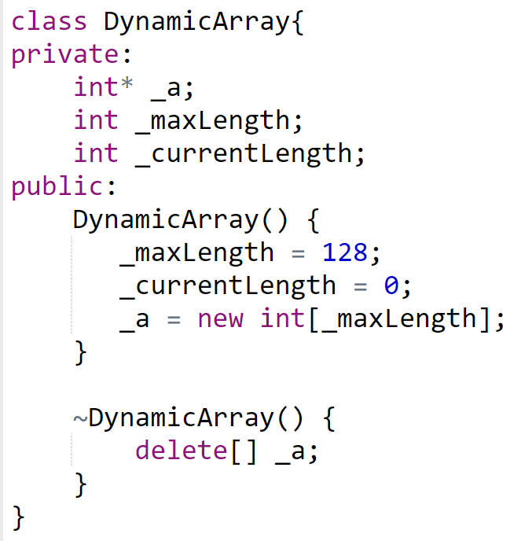
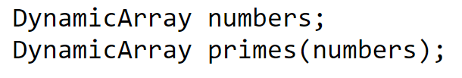
Problem with default copy constructor
Shallow copy

Slide 52
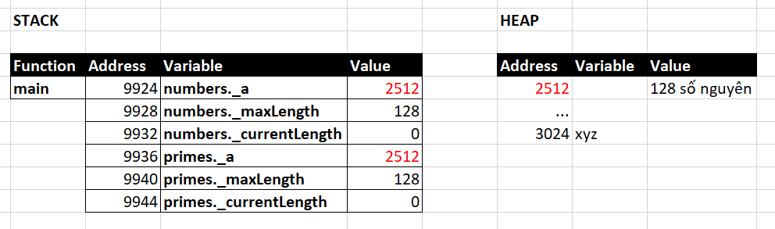
What happen on stack?

Slide 53
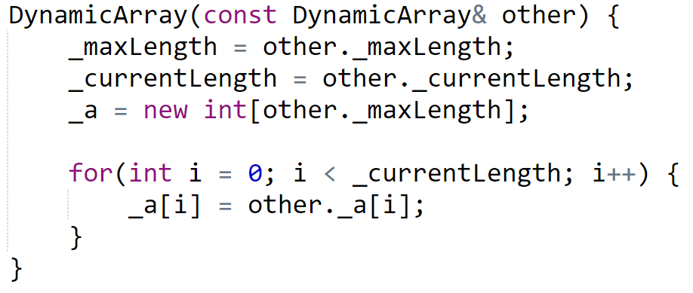
Deep copy
This is why we need copy constructor

Slide 54
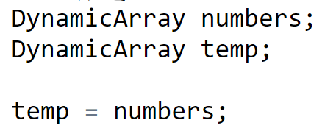
Assignment operator
Again, the automatically generated assignment operator is the problem

Slide 55
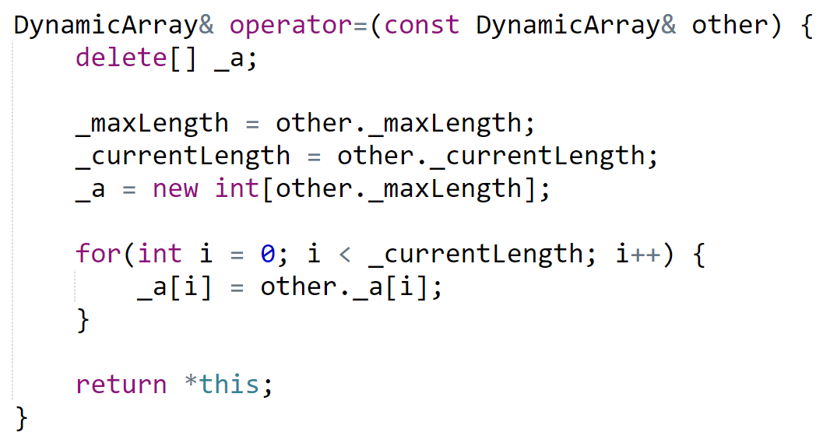
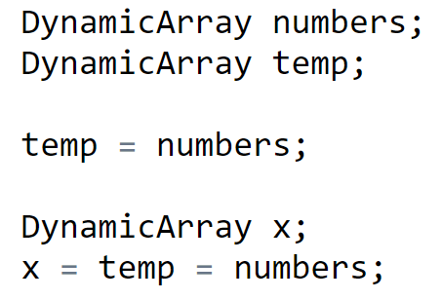
Implement assignment operator

Slide 56

Tricky situation
Copy constructor or assignment operator?
The answer is copy constructor

Slide 57
Rule of three
If a class define one of the followings, it should define all of the others
destructor
copy constructor
copy assignment operator

Slide 58

‘const’ position

Slide 59
Exercise – Which line of code is valid
const Cat* kitty = new Cat(0.01, 0.02);
kitty->

Slide 60
Static members

Slide 61
Characteristics
Static members exist before class initialization
Can be accessed starting from class name

Slide 62

Class Point

Slide 63


Usage

Slide 64

Class Circle

Slide 65

Shortcut to initialize static members
inline

Slide 66
Input & Output

Slide 67
Behind the scene of operator
swap(oldValue, newValue)
a + b
operator+(a, b)
2 + 8 + 10 + 11
operator+( operator+( operator+(2, 8), 10) , 11 )
4 * 3 – 2 / 1 + 16
operator+( operator-( operator*(4, 3), operator/(2, 1)) , 16)

Slide 68
Behind the scene of cin
cin >> x >> y >> z >> m;
operator>>(cin, x)
operator>>(cin, y)
operator>>(cin, z)
operator>>(cin, m)
istream& operator>>(istream& , int&)

Slide 69
Behind the scene of cout
cout << x << y << z << m;
operator<<(cout, x)
operator<<(cout, y)
operator<<(cout, z)
operator<<(cout, m)
ostream& operator<<(ostream& , int&)

Slide 70
What we want
Point* p = new Point() ;
cin >> p;
cout << p;
How to do it?
operator overloading

Slide 71

Input overloading

Slide 72
friend operator
Allow a non-member function can access the private and protected members of a class

Slide 73

Output overloading

Slide 74
Exercises
Point , Line, Rectangle, Triangle, Circle
Fraction
Time, Date
Random, Dice, DiceGame
DynamicArray
Student

Slide 75

Exercise
Given this main method
Design and implement class Fraction

Slide 76
Note
Where to put GCD function? Inside class Fraction or not?
Should the Plus function be static?
Should we overload operator+?
Do we need getter/ setter?
Do we need constructor & destructor?
Difference between swap(int*, int*) and swap(int&, int&)

Slide 77
Question?

